Slide 1
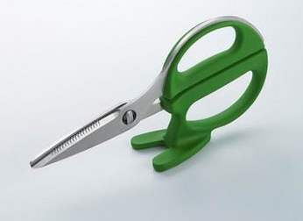
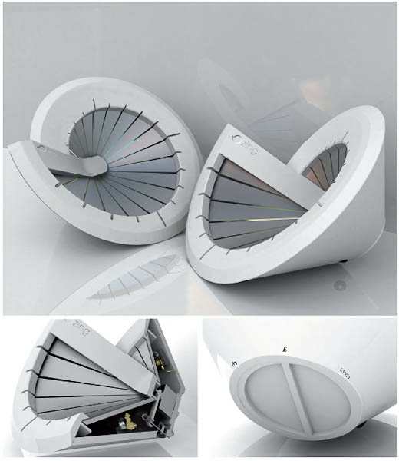
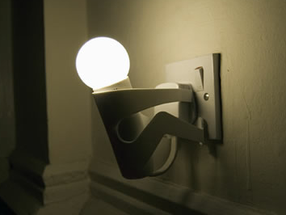

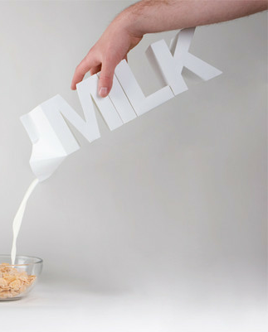
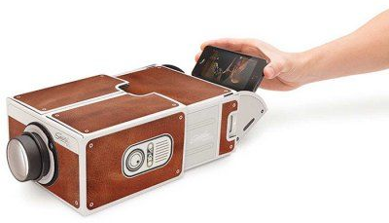
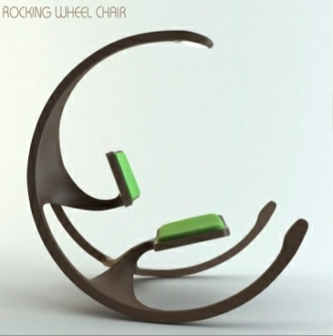
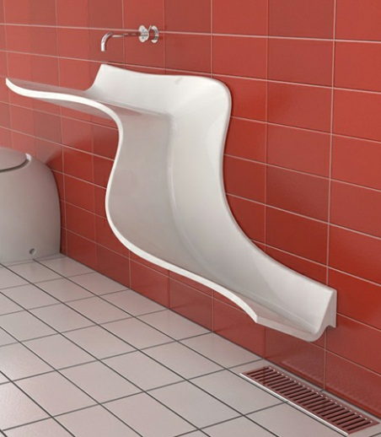
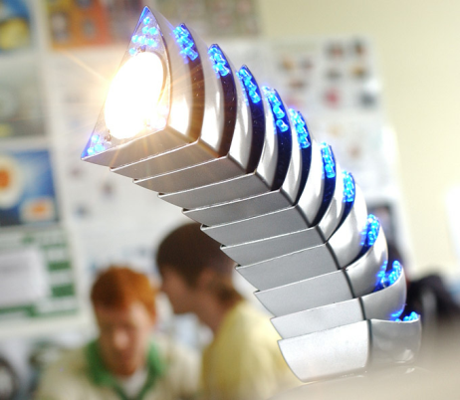
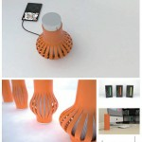
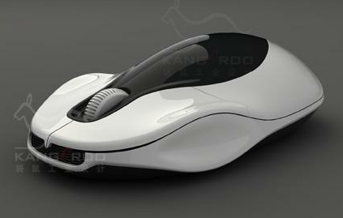
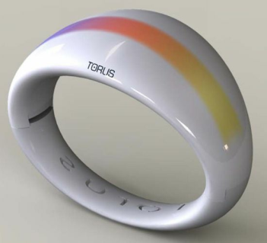
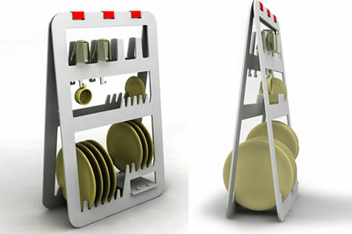
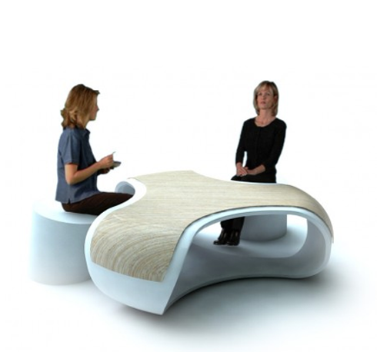
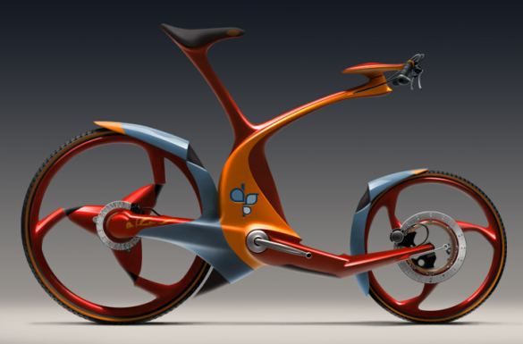
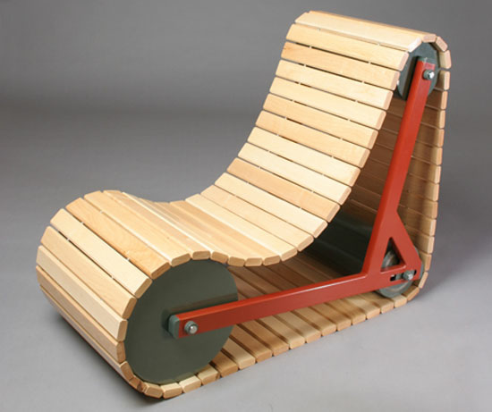
DESIGN
iGCSE Design Technology Introduction
Notes:
Demonstration of pewter casting
- Features of moulds & potential issues
- Demonstration of hand made mould to
pewter casting
- Student create practice mould using hand
tools and cast.

Slide 2

IGCSE Design Technology
Task.
DESIGN
Draw a 3D table.
Sustainability
User Centred Design

Slide 3

IGCSE Design Technology
Think Pair Share
DESIGN
What is...
Design Technology
What do you want from the course?

Slide 4
IGCSE Design Technology
Importance of Design thinking
DESIGN

Slide 5
IGCSE Design Technology
Aims
The aims are to enable students to:
• Develop creative thinking in areas relevant to design and technology
• Apply problem-solving skills to practical and technological problems
• Develop the communication skills central to design, realisation and evaluation
• Gain knowledge and understanding of design and technology
• Develop skills in research and investigation
• Design and make products, taking into consideration sustainability and the
wider impact on society
• Develop the ability to make aesthetic, economic, ethical and technical value
judgements.
DESIGN

Slide 6
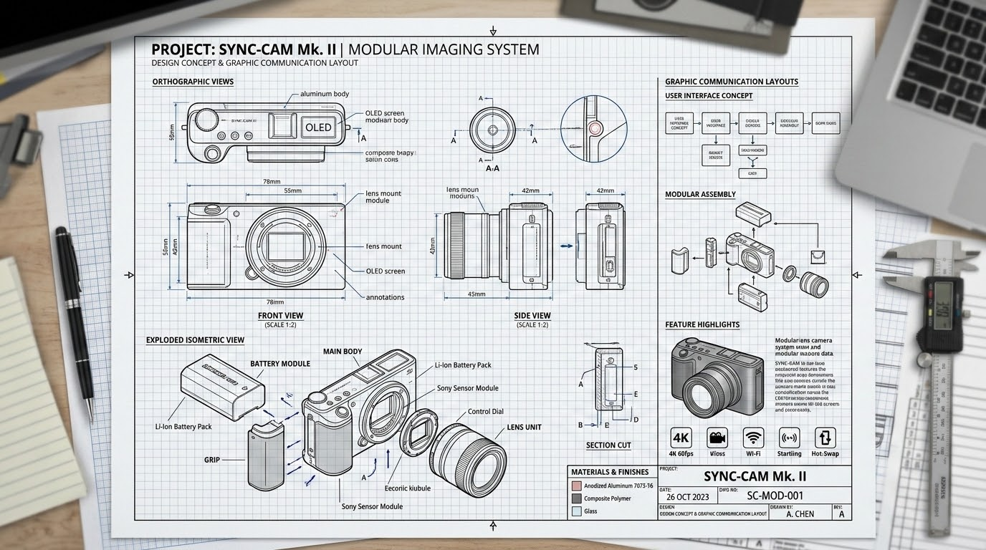
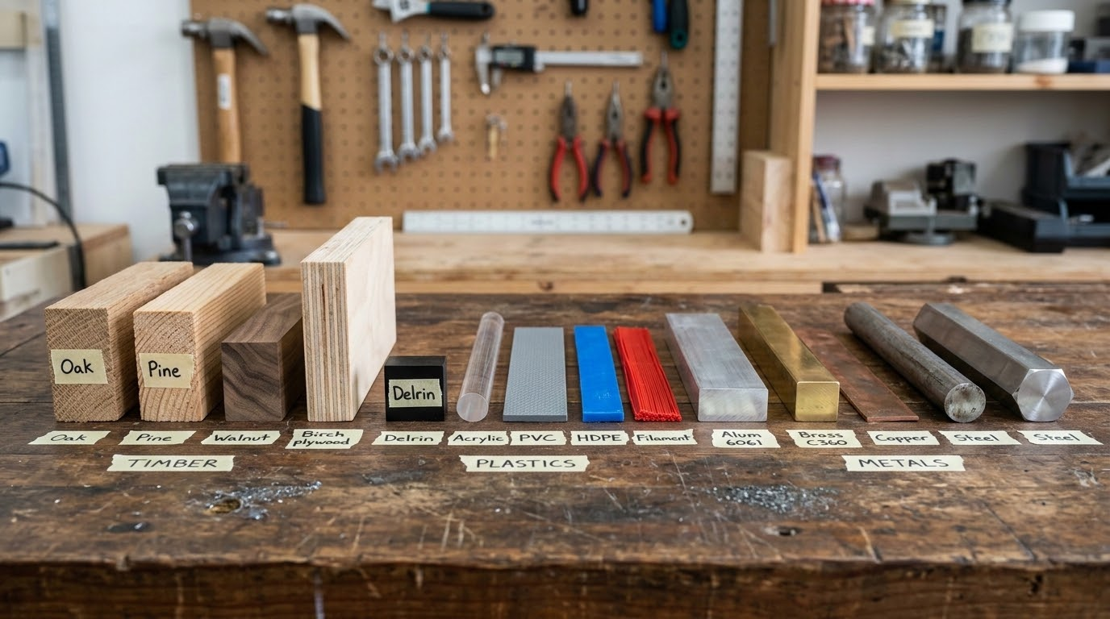
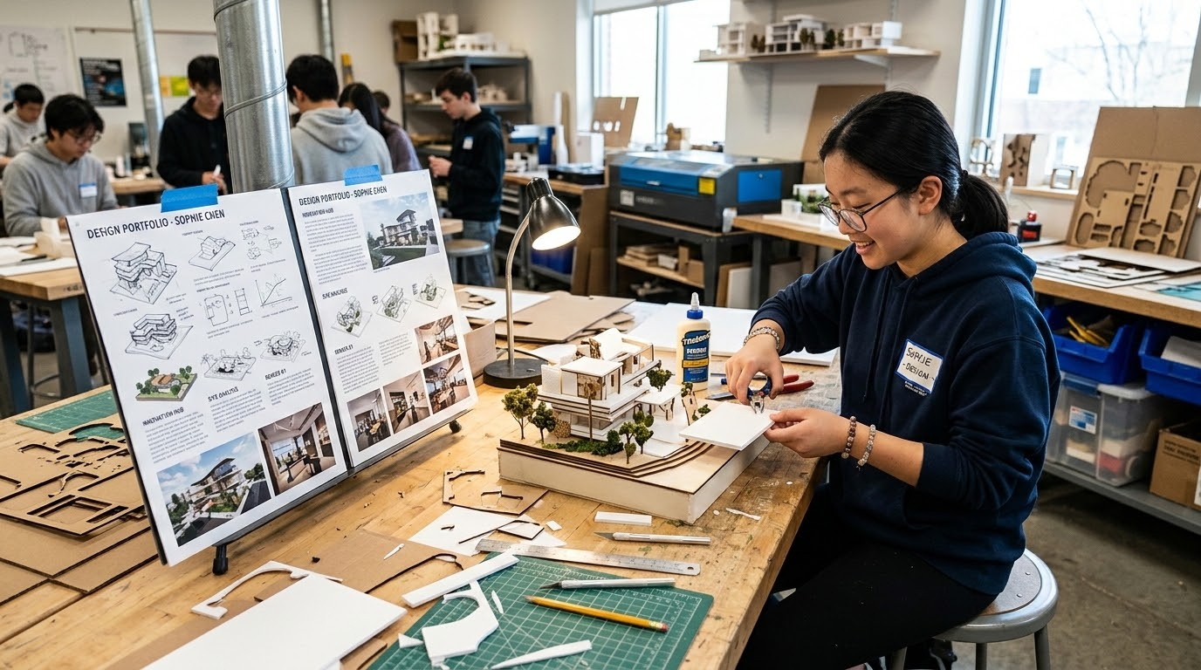
IGCSE Design Technology
Assessment Components
2026-28
DESIGN
Design Knowledge (25%)
Materials & Process (25%)
Coursework Project (50%)
50 Marks - Written Paper
Focuses on designing principles and common knowledge around creative graphic communication.
Externally Assessed
50 Marks - Written Paper
Tests specialist knowledge of materials, industrial manufacturing, and fabrication processes.
Externally Assessed
100 Marks - Design Portfolio
Personal project involving research, development, and crafting a complete physical prototype.
School-based & Moderated Externally

Slide 7
IGCSE Design Technology
Assessment
Candidates will be eligible for grades A* to G.
DESIGN
Design Knowledge Exam | Material & Process Exam | Coursework Project
25% - 50 Marks | 25% - 50 Marks | 50% - 100 Marks
Written paper based on designing and common knowledge around design and graphic communication Externally Assessed | Written paper based on specialist content of materials, processes and manufacturing methods Externally Assessed | Personal Design Project following the design process creating a portfolio and prototype School-based assessment. Internally assessed and externally moderated.

Slide 8
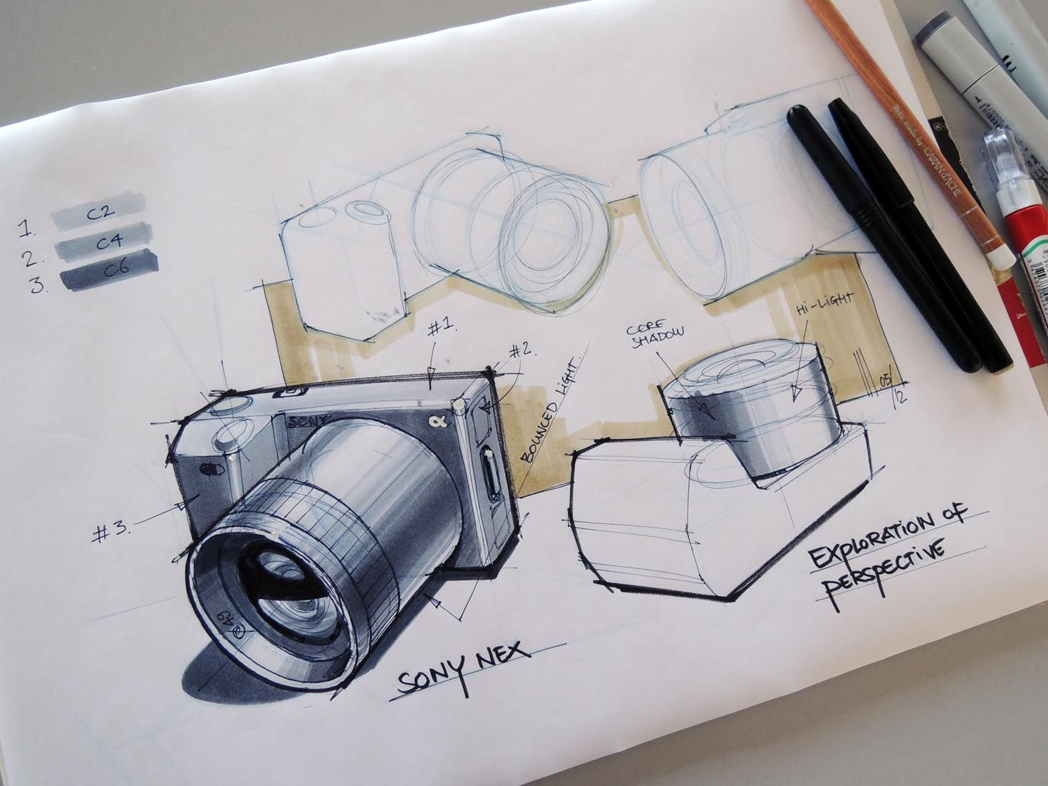
IGCSE Design Technology
Content
Core Knowledge - Paper 1
Influences on Design
Design principles
Communicating Designs
Making Principles
Material Classification
Structures
Mechanisms
Electronics
DESIGN

Slide 9
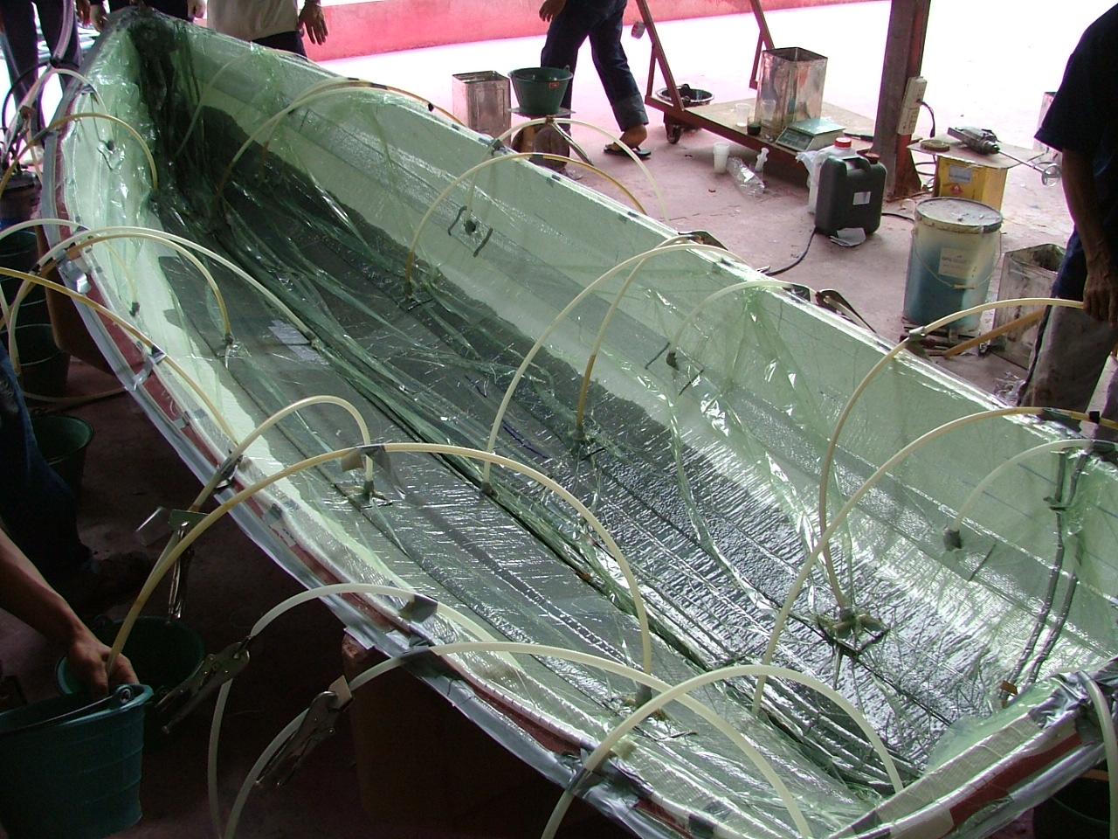
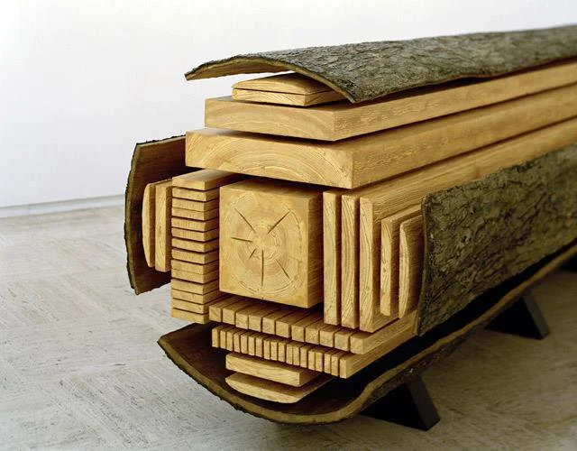
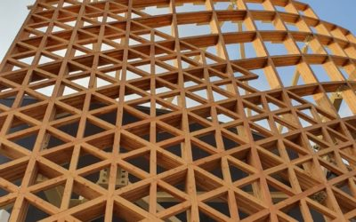
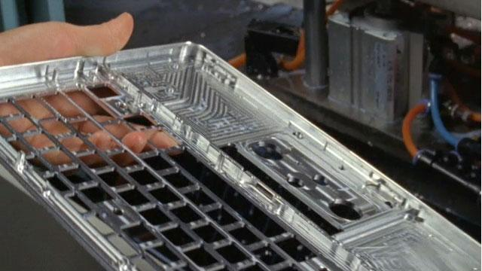
IGCSE Design Technology
Content
Specialist content - Paper 2
Types of material
Manufacturing Processes
Commercial Manufacturing Methods
Product Analysis
Use of Technology
DESIGN

Slide 10
IGCSE Design Technology
IB Design Technology - Group 4
Standard Level
Ergonomics and user centered design
Design for sustainability and circular economy
Prototyping and modelling
Materials, properties and selection
Inclusive design and responsibilities of the designer
Design Process
Higher Level Extension
Beyond usability
Structural, Mechanical & Electronic Systems
Manufacturing techniques
Production systems
Design for manufacture
DESIGN
IGCSE to IB Progression
The IGCSE Design Technology content directly links with
IB DT Content, giving you an advantage on your understanding.

Slide 11

IGCSE Design Technology
Career Opportunities
Product Designer
Engineer
Architect
Interior designer
Graphic designer
Ergonomist
Electronics engineer
Material Engineer
Design teacher
Manufacturing Engineer
Structural Engineer
Furniture designer
Health and safety
Illustrator
Mechanical engineer
Systems developer
Civil Engineer
DESIGN
Building Character traits and thinking that can be used in other subjects and desired at universities and careers.

Slide 12
IGCSE Design Technology
Independence & Support
DESIGN
Independence
Take ownership of your creative journey and manage your project time effectively.
Independently work around lessons to stay on track.
Do your own stuff—explore personal design interests.
Experiment, be creative, and think differently.
Work ahead independently using the provided guides.
✦Support
Leverage the design studio resources and expert teacher guidance available to you.
Use the DT Labs and take advantage of GCSE freetime.
Talk to your teacher regularly to ask for guidance.
Proactively ask for constructive feedback on your designs.

Slide 13
IGCSE Design Technology
Resources
- Guides and examples
- Resources and videos
- Updated knowledge from exam questions
- Coursework guides
- Assessment
DESIGN
bit.ly/islanddt
- Create a shortcut on your Computer.

Slide 14
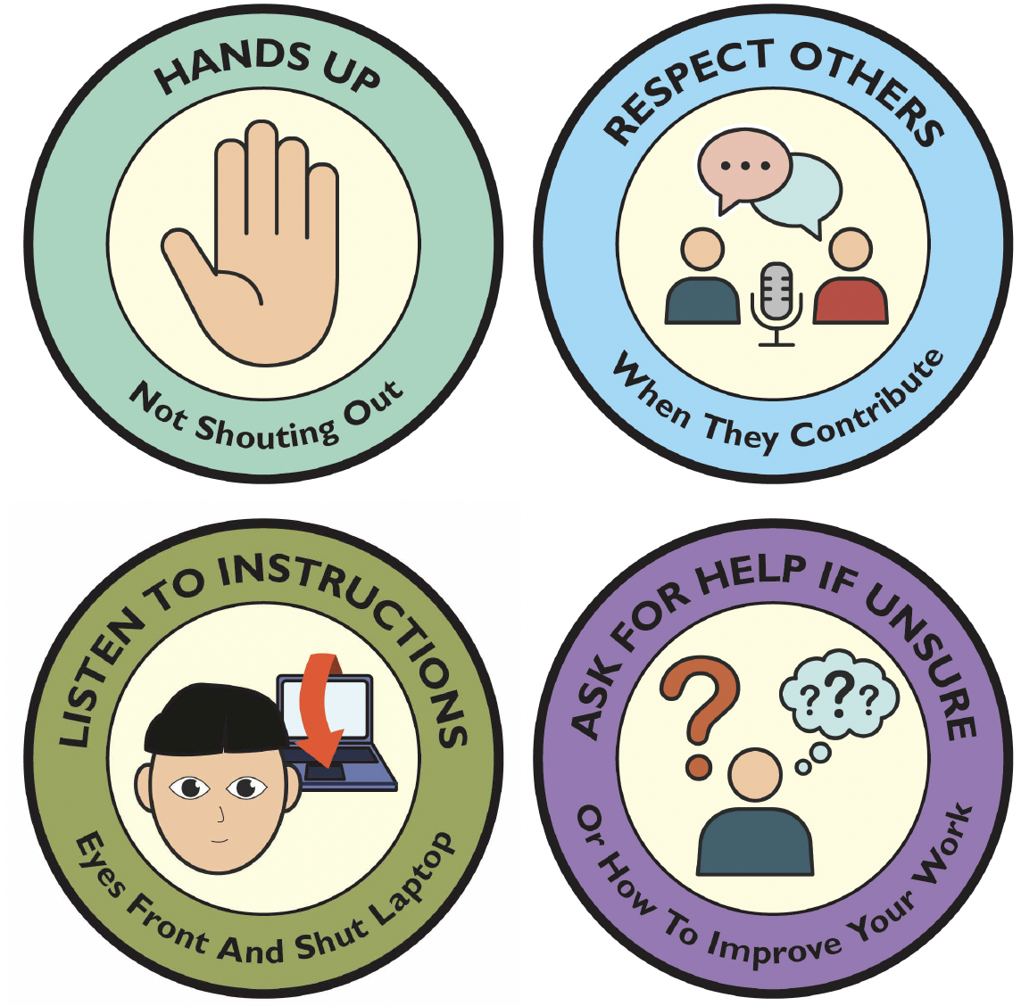
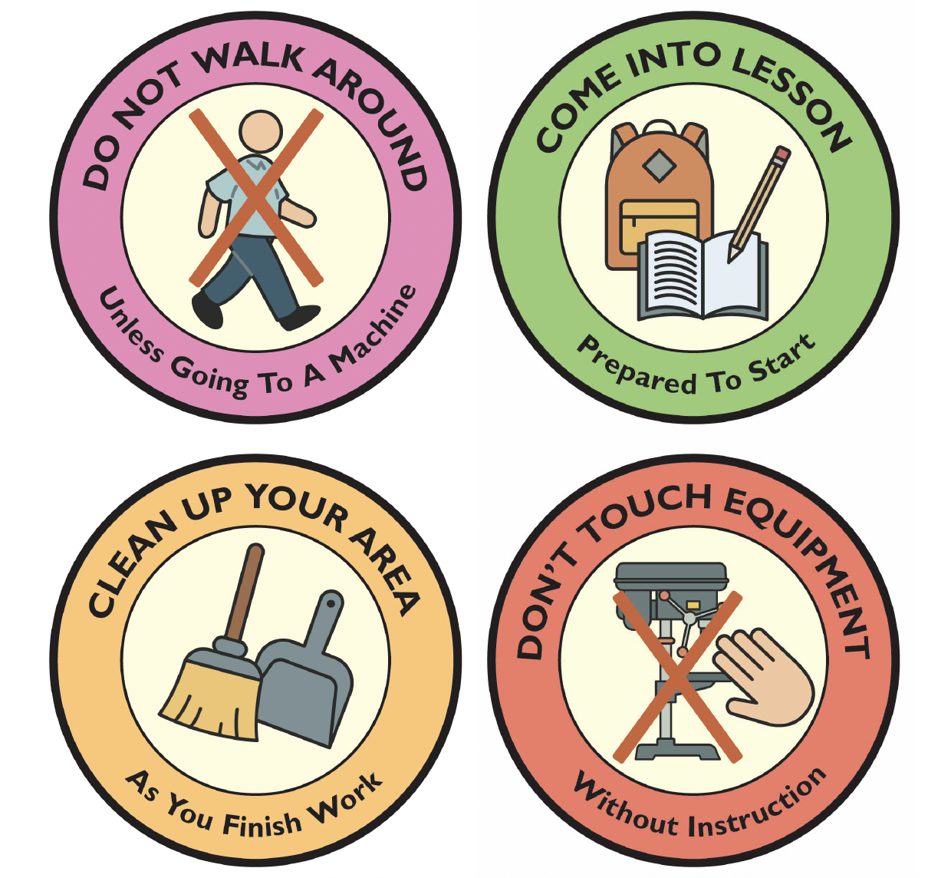
IGCSE Design Technology
Classroom/workshop rules
DESIGN

Slide 15
IGCSE Design Technology
Wind Catchers
Design Brief:
Design and make an ornament that uses
wind power to create movement.
DESIGN
Criteria:
It must be made out of acrylic.
It must have 1 form of heat process in its manufacture.
It must have surface detail that follows a theme
It must have at least one shape modification
It must not have any sharp corners
It must have a high quality finish.
Learning Objectives:
Review material Properties and properties of acrylic
Discuss plastic categories
Learn how to work plastics by hand
Use of heat to manipulate plastics
Discuss importance of quality and aesthetics of a product

Slide 16
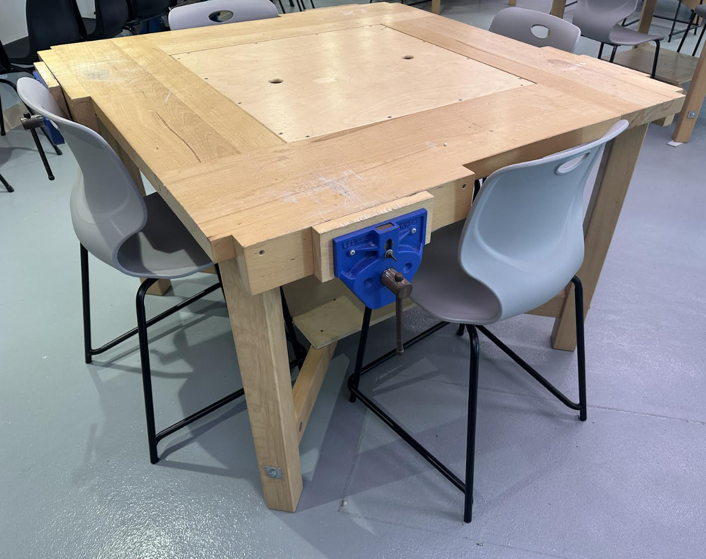

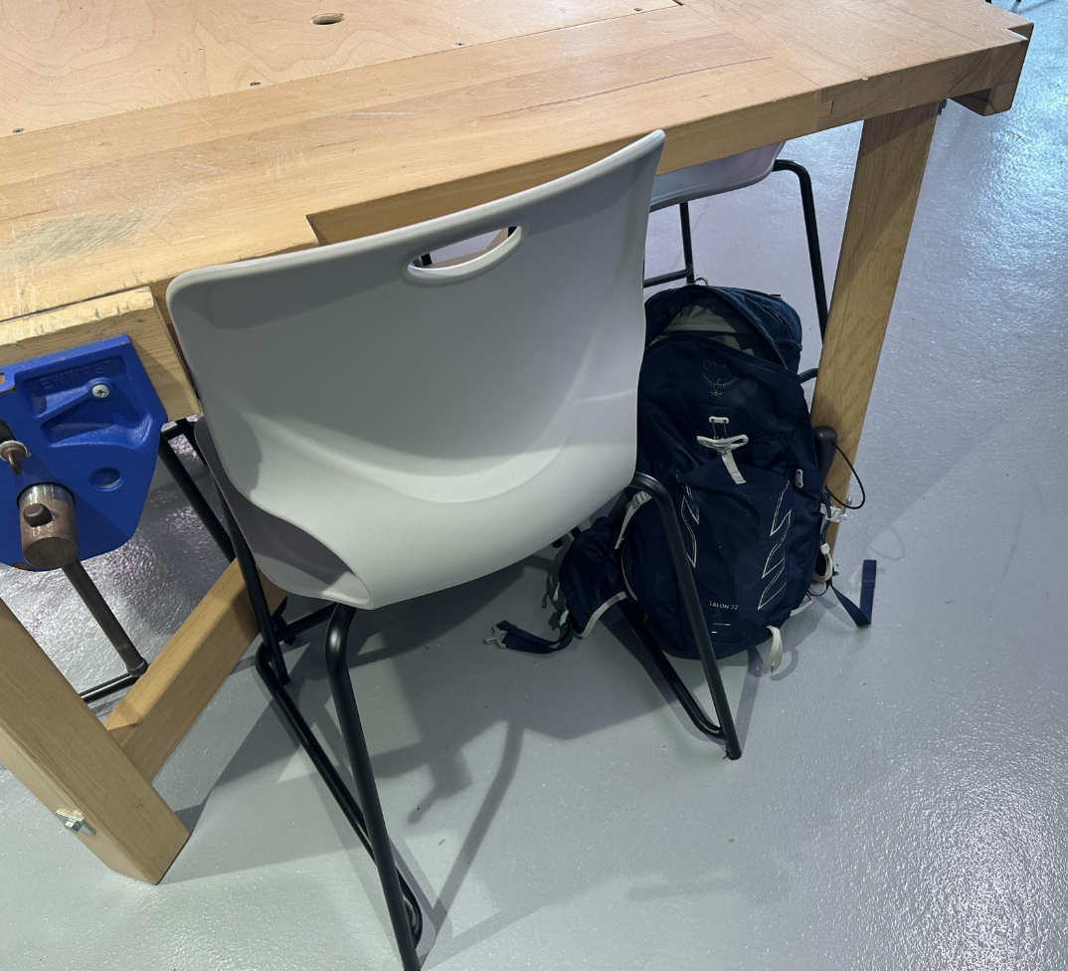
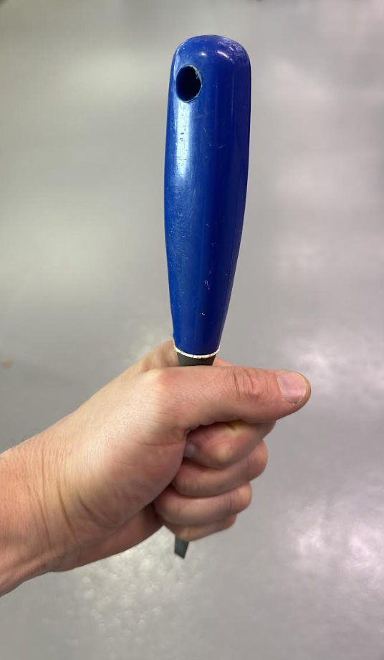
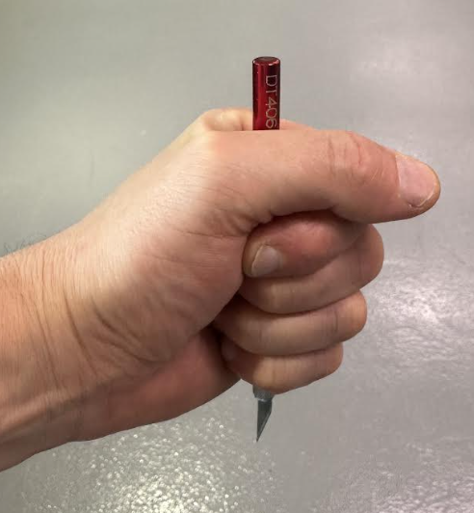
IGCSE Design Technology
Safety in the workshop
Stools under table
No running
DESIGN
Bags under table
or outside
Carry sharp tools down
and covered by hand

Slide 17
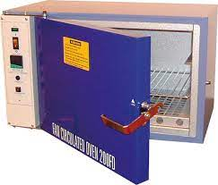
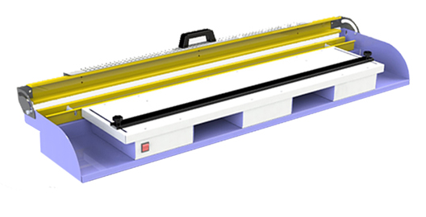
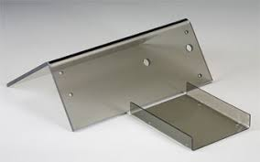
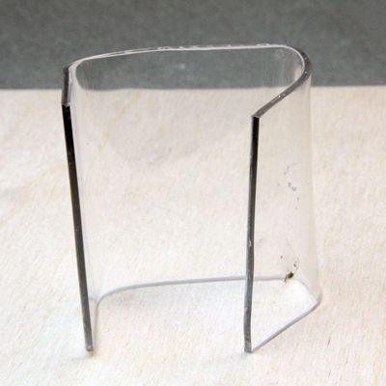
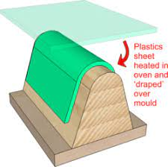
IGCSE Design Technology
Line Bending
Convection Oven
DESIGN
Heats only a line of plastic
Heats the plastic, but a mould is needed to create a quality outcome

Slide 18

Sustainables - Design
Character Skills
Plastics
Think-Pair-Share
DESIGN
Why do we use plastics?
Why is plastic unsustainable?
How can we use plastics more sustainably?

Slide 19
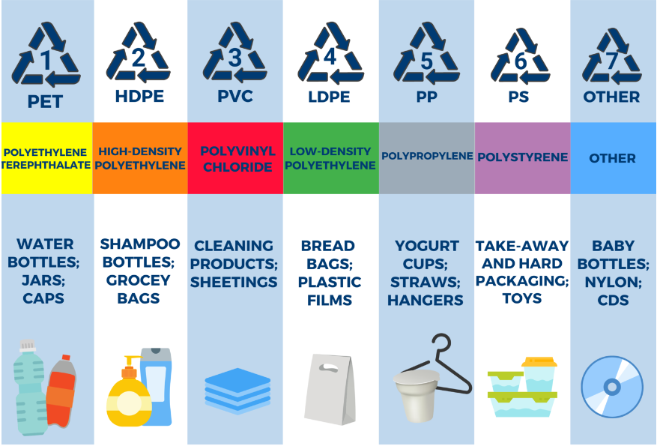
Sustainables - Design
Recycling Plastic
Name the plastic and what its used for…
DESIGN
A Thermoplastic can be melted and reformed.
A Thermoset Plastic, once formed, cannot be recycled or reshaped.
Symbols are found on most thermoplastics to help identify and separate for recycling.

Slide 20
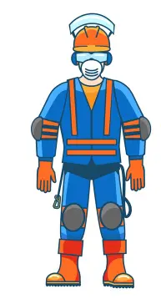







IGCSE Design Technology
PPE
What does PPE stand for?
DESIGN
Personal Protective Equipment
Which PPE should you use for each machine?

Slide 21






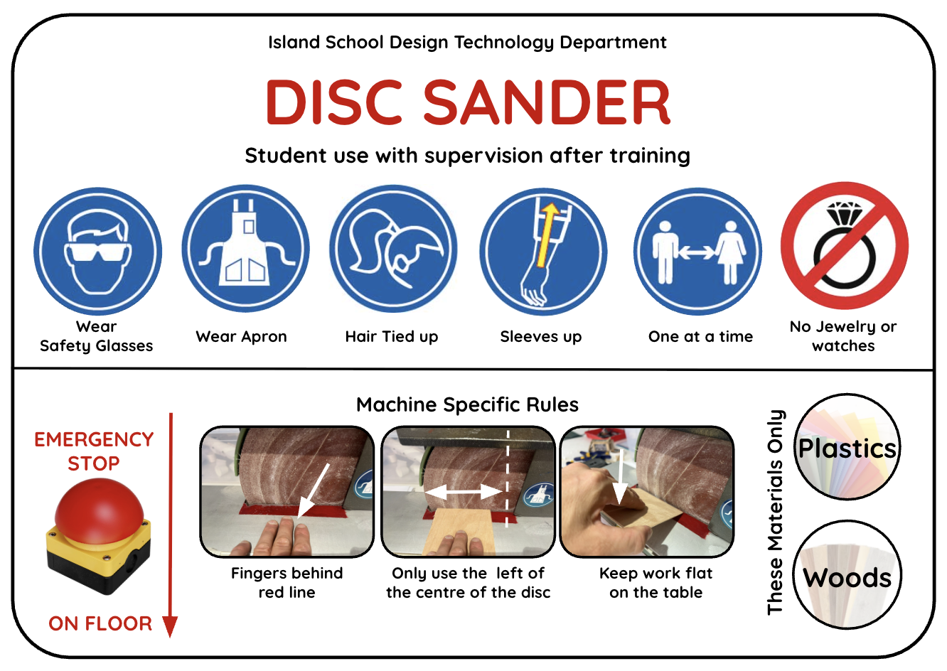
IGCSE Design Technology
General Machine Safety
DESIGN
Wear
Safety Glasses
Wear Apron
Hair Tied up
Sleeves up
One at a time
No Jewelry or watches
Who can use it
General Safety Rules
Types of materials you can use on the machine
Specific Safety Rules

Slide 22
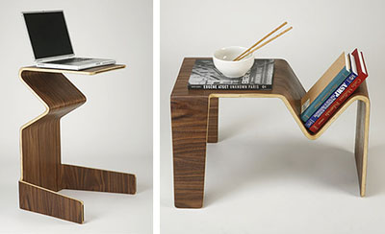
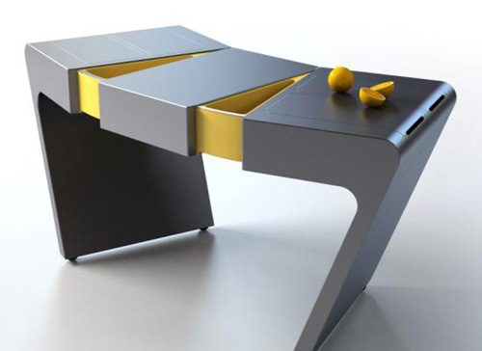
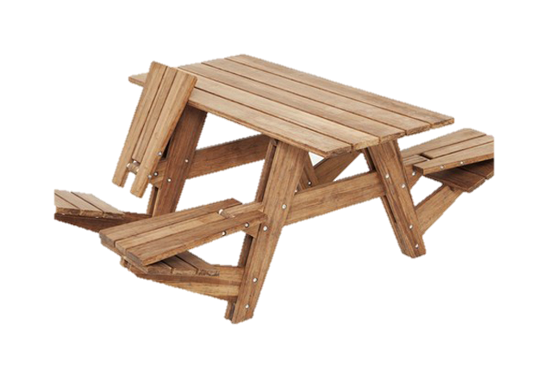
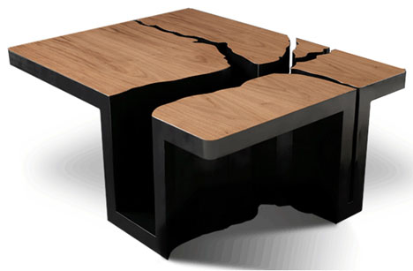
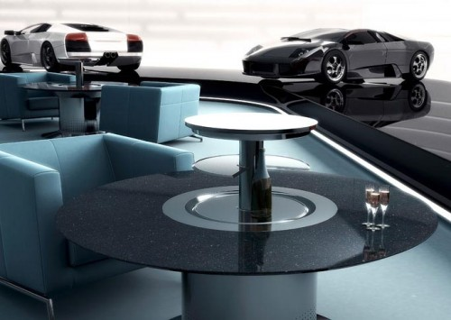
IGCSE Design Technology
Rethink - 3D Table?
DESIGN

Slide 23
IGCSE Design Technology
Table Redesign
Now look at your first table drawing.
Is it creative? Do tables have to have a set number of legs or be a set shape?
Task.
Now re-design your table trying to be more creative. It may help to think of a user, theme, or environment (place) it will go in.
DESIGN

Slide 24







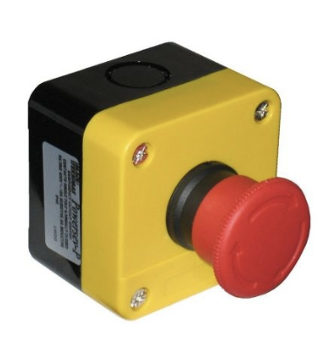
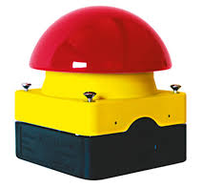
IGCSE Design Technology
Health & Safety Symbols
What do these symbols / items communicate and what are they called?
DESIGN
Fire extinguisher
toxic
corrosive
harmful / danger
flammable
Emergency stop button
First Aid Equipment

Slide 25
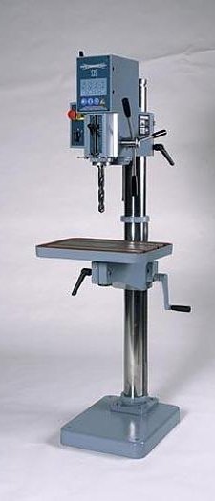
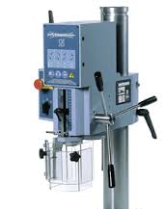
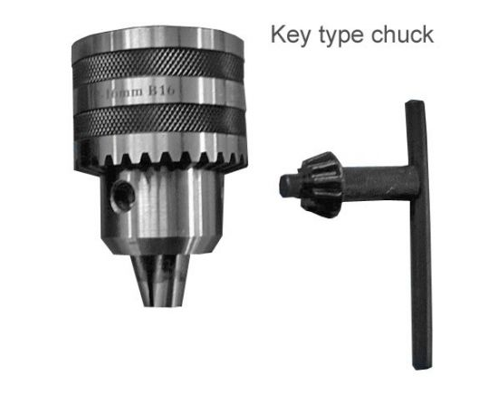
IGCSE Design Technology
Parts of the pillar drill
Gear box
DESIGN
Emergency Stop
Feed handle
Depth Gauge
Chuck
Drill bit
Table
Chuck guard
Table adjustment
Pillar
Chuck Key

